Slide 1
The Matrix Map
Facilitating Strategic Discussions about Sustainability

Slide 2

Welcome!
“How do you know when a program is (or isn’t!) a ‘keeper’ within your organization?”

Slide 3

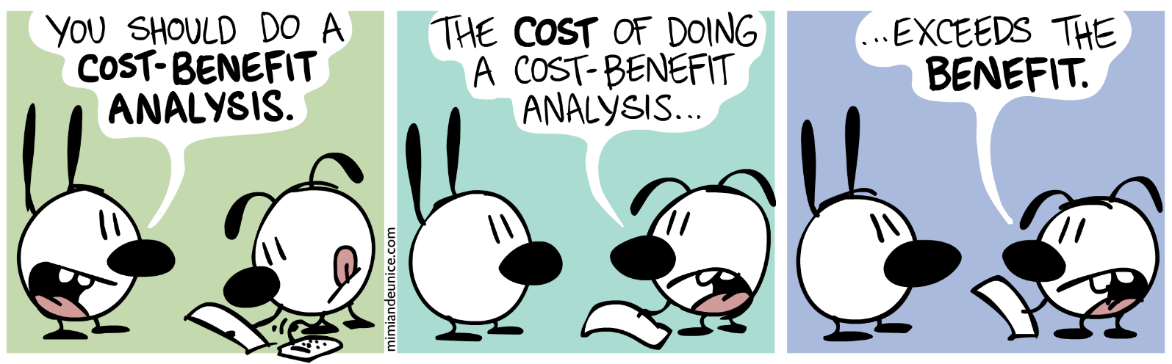
Cost Benefit…

Slide 4
Guiding Fiduciary Question
Are we effectively and efficiently investing the resources the organization acquires to strategically advance community benefit and achieve our outcomes in a manner that is sustainable over time?
Notes:
Embedded in this definition is an understanding that an organization is interdependent. There are many aspects to consider and balance to be sustainable and effective – A fiduciary needs to be attuned to all of those

Slide 5

A Nonprofit Tale
Once upon a time, in a nonprofit far, far away…

Slide 6
A Nonprofit Tale
Assuming you know that a specific program:
  Has a strong financial position
  Accomplishes its programmatic outcomes as intended
  What else would it take to determine whether the program is a good fit for the organization?
Notes:
Alt: What other information would the nonprofit leadership team need in order to determine whether or not to recommend to their Board that they continue to run this pilot program?

Slide 7



Guiding Questions
To what extent do we understand our program’s…
    Financial performance?
    Alignment with our organization and its strategy to achieve community benefit?
    Achievement of outcomes and process evaluation indicators?
    Consumption of organizational effort?
Notes:
Process evaluation = effective at implementing approach

Slide 8
To what extent do we understand our program’s:
Financial performance?
Program level budgeting and accounting (revenue and expense)
Accurate salary/time allocation and tracking
Realistic shared and core cost allocation
My Great Program
Revenue | Restricted & Earned
Program Expenses | Line Item
Salary Expense | Tracked
Allocated | Admin & Shared
True Profit/Loss

Slide 9
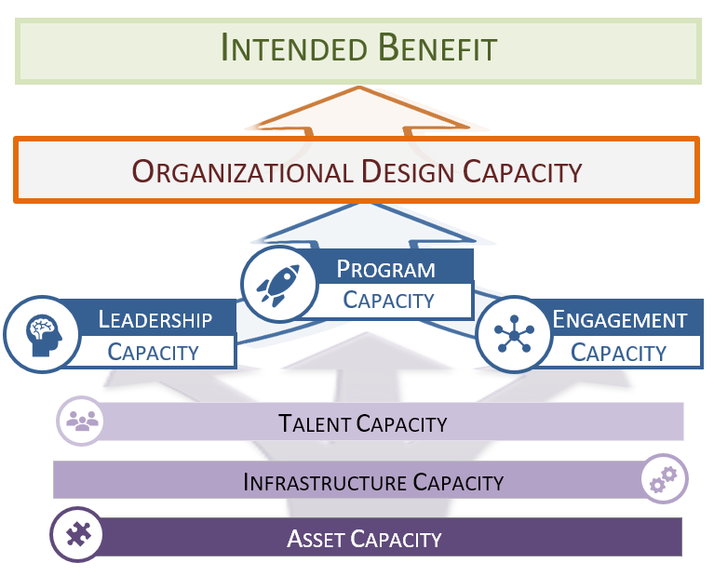
Program Capacity
What consistent criteria and process do we use to decide whether to invest in, reduce, or eliminate a program/effort?

Slide 10
To what extent do we understand our program’s:
    Alignment with our organization and its strategy to achieve community benefit?
  Community Benefit
      The overall affect we have on the community, such as filling a gap or unmet need
  Strategy
      Our overall theory and assumptions of what it takes to affect change, such as scale or volume, depth
  Approach
      The way we have designed our programs and our organizational structure to maximize leverage, excellence in execution, or other criteria
  Values

Slide 11
To what extent do we understand our program’s:
Achievement of its intended outcome and process evaluation indicators?
What
difference
did we make?
How well did
we do it?
What did we do?
Outcomes
(Benefits)
Outputs
(Process)

Slide 12
SAMPLE Matrix Map Programmatic Measurements*
Contribution to intended community benefit (required)
Excellence in execution
Scale or volume
Depth
Filling an important gap or unmet need
Community building
Leverage
*Sustainability Mindset; Bell & Zimmerman; 2015

Slide 13

Your Programmatic Measurements…
Using the worksheet, consider what criteria could be used to determine …
Alignment w/ Organization and Strategy
Community Benefit (overall affect we have on the community)? Strategy (overall theory and assumptions of what it takes to affect change)? Approach (the way we have designed our programs and our organizational structure)? Values?

Slide 14
To what extent do we understand our program’s:
Consumption of Organizational Effort?
  What will help us better understand the demands of a program and what we put into it?

Slide 15
Your Programmatic Measurements…
Using the worksheet, consider what criteria could be used to determine …
Organizational Effort

Slide 16
Guiding Questions
To what extent do we understand our program’s…
    Financial performance?
    Alignment with our organization and its strategy to achieve community benefit?
    Achievement of outcomes and process evaluation indicators?
    Consumption of organizational effort?
Notes:
Process evaluation = effective at implementing approach

Slide 17

Purpose of the Matrix Map Tool
The Matrix Map is a tool intended to support an organization’s fiduciaries in defining and applying consistent criteria to decide whether to invest in, reduce, or eliminate a program and/or organizational effort.
Notes:
A powerful thing happens when you know and can articulate your outcomes – you can then engage people in talking about and using them to evaluate and plan
we first need to know that we are supposed to connect these things, next we want to engage in inquiry that gets us asking about all the elements, THEN we need to have criteria to screen the answers we get to make a decision about what is best for the organization

Slide 18
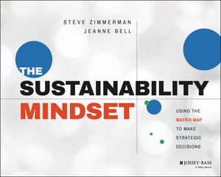

Slide 19
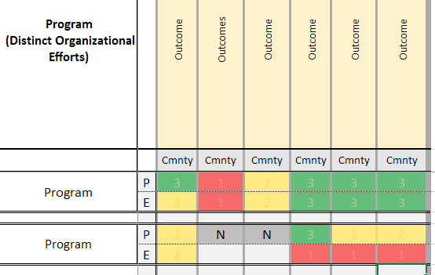

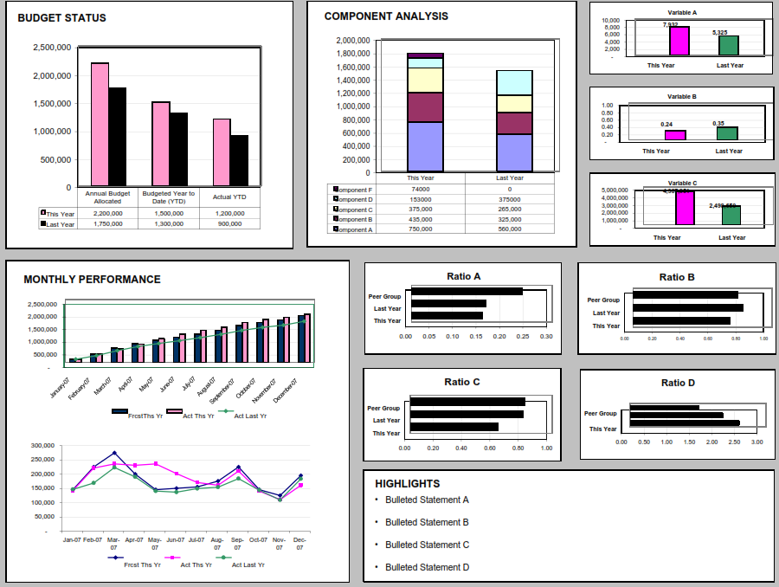
Connecting Outcomes to Operations
Community Outcomes
Organizational Strategy
Resource Engagement & Utilization
STRATEGY SCREEN
?
REPORTS
Notes:
Strategy = Program Portfolio (Heart of the organization and where actual change happens)

Slide 20



Matrix Map – Sustainability Screen
Community Outcomes
Resource Engagement & Utilization
Organizational Strategy
Mission Advancement
Effectiveness
Profitability
Efficiency
Adapted from Nonprofit Sustainability; Bell, Zimmermen; 2015
Notes:
Links mission to money and resource allocation

Slide 21
How to Use The Results
Contain Costs,
Scale Carefully
Invest, Scale Up
Vision Advancement
Profitability
Shut down, give away
Raise relevance, harvest resources
Adapted from Nonprofit Sustainability; Bell, Zimmermen; 2015
Notes:
Links mission to money and resource allocation

Slide 22
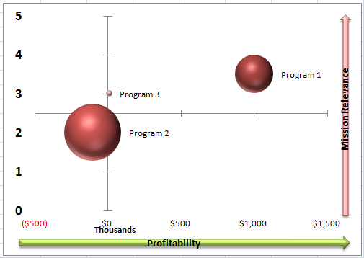
How to Use The Results
The Real Strategic Planning

Slide 23
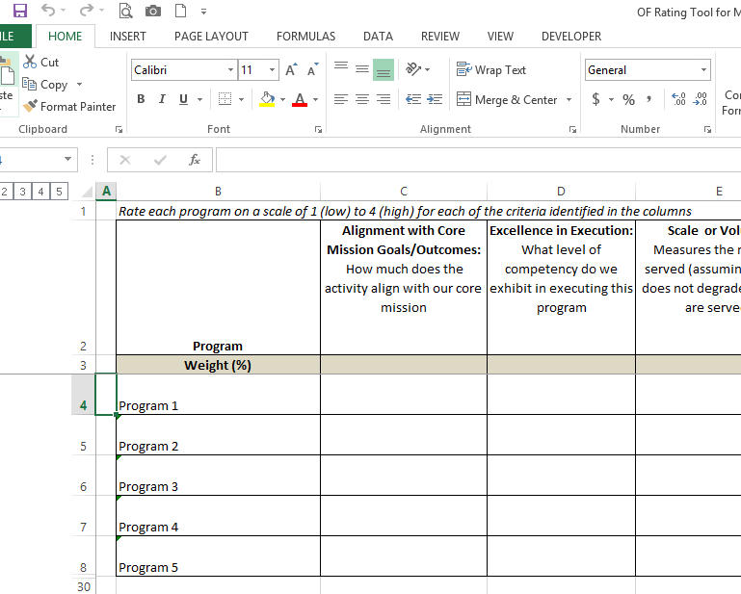
Let’s Build One

Slide 24
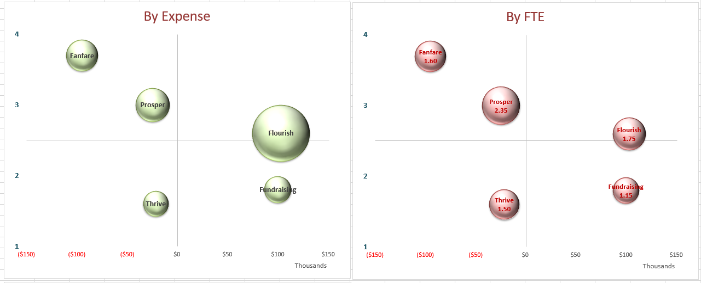
Root to Canopy Example
Notes:
In small groups they are asked to analyze the example data and determine what needs attention, what they have questions about, what is odd.

Slide 25
Guiding Questions
To what extent do we understand our program’s…
    Financial performance?
    Consumption of organizational effort?
    Achievement of outcomes and process evaluation indicators?
    Alignment with our organization and its strategy to achieve community benefit?

Slide 26
Guiding Fiduciary Question
Are we effectively and efficiently investing the resources/assets the organization acquires to strategically advance community benefit and achieve our outcomes in a manner that is sustainable over time?
Notes:
Embedded in this definition is an understanding that an organization is interdependent. There are many aspects to consider and balance to be sustainable and effective – A fiduciary needs to be attuned to all of those

Slide 27
Reflection on Benefit
What is standing out for you?
What do feel more comfortable, confident, and/or competent doing?

