Slide 1
A Presentation of the Study on Compensation and Benefits of Nonprofits in Montgomery County, Maryland
June 14, 2022
Notes:
Welcome and thank you for joining us.

Slide 2
Our Research & Evaluation Team
Tameka Payton, Ph.D.
Chief Executive Director
Tonya Ross Taylor, M.S.
Christopher D. Hill, Ph.D.
Data Analyst
Assistant Director for Research and Evaluation

Slide 3
Presentation Agenda
Overview of the Studies
Maryland Nonprofit
Nonprofit Montgomery
Overview of Methodology
Findings
Key Points

Slide 4
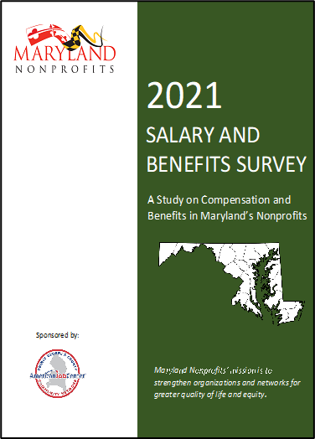
2021 Salary and Benefits Survey: A Study on Compensation and Benefits in Maryland’s Nonprofits
Published Biennially
Delayed a Year Due to COVID – 19
Administered March through April 2021
Published June 2021
Notes:
Discuss Biennial collection (every 2 years); most recent report was published in 2018
2020 collection was postponed due to COVID-19
Methods of collection from across the state; methodology was consistent across both collections; impact of COVID on the data is unknown.
More than 350 respondents representing nonprofit organizations across all regions of Maryland participated in the survey from March through April 2021.
This report presents the findings related to various types of compensation—monetary benefits, non-monetary benefits, and fringe benefits —for these organizations in Maryland.

Slide 5
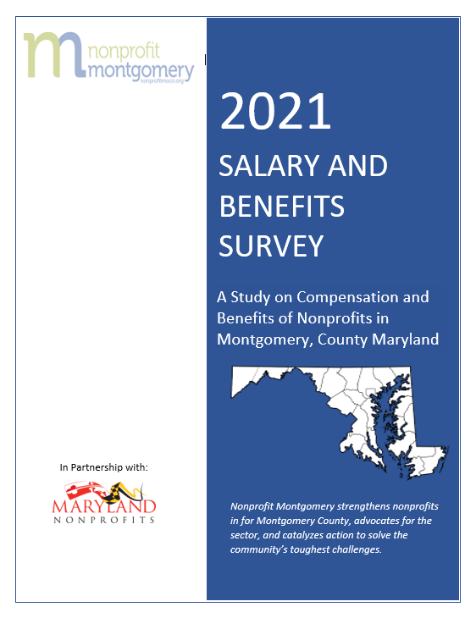
Purpose
This report:
Examines the salary and benefit trends of nonprofit organizations in Montgomery County, Maryland
Aims to help organizations establish salary goals for their employees that are both competitive and fair.

Slide 6
Methodology
Survey Instrument
Four sections
Contact information & organizational profile
Benefits
Employee Group and Salary
Additional Comments
264 select response and open-response
Procedures
Three-week administration period
March 17 to April 9, 2021
Survey sent to 8,551 potential respondent organizations.

Slide 7
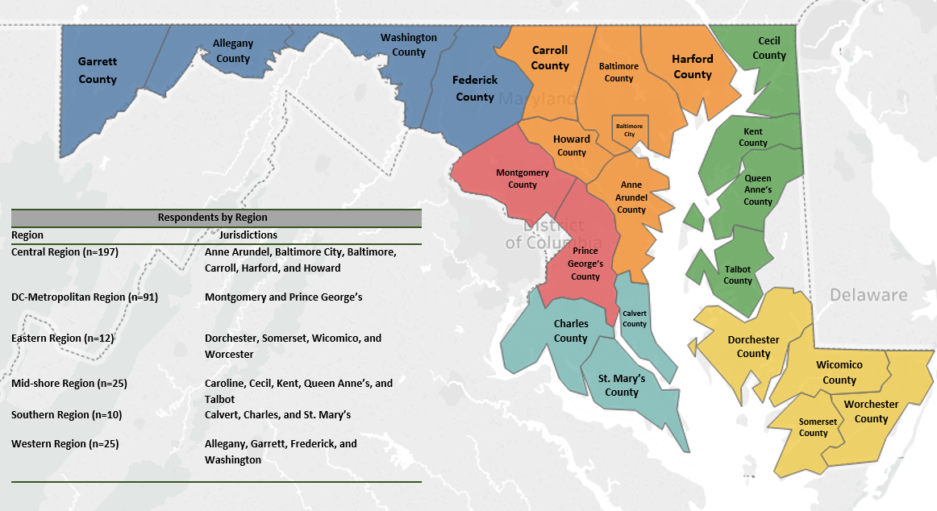
Respondent Organizations by Region
Respondent organizations were from 23 MD jurisdictions.
The respondent organizations were arranged according to their geographical regions: Central Region, DC-Metropolitan Region, Eastern Region, Mid-Shore Region, Southern Region, and Western Region.
Most respondent organizations reported that their organization is in the Central Region.
DC Metro Region reported the highest number of respondent organizations (25%). Montgomery County reported the 2nd highest number of respondent organizations (17%)
Notes:
Respondent organizations were asked to identify their jurisdiction in the survey. Respondent orgs were from 23 of the 24 MD jurisdictions (No responses from Caroline County). The respondent organizations were arranged according to their geographical regions: Central Region, DC-Metropolitan Region, Eastern Region, Mid-Shore Region, Southern Region, and Western Region. Most respondent organizations reported that their organization is in the Central Region. One jurisdiction (i.e., Caroline) is not shown on the map, as no respondent organizations were reported from this jurisdiction.
The three-week survey administration yielded 370 responses from respondent organizations, with approximately 20% reporting their location as Montgomery County. 61 orgs

Slide 8
Executive Directors/Officers in Montgomery County
Presentation of Findings for the
Notes:
In the 2021 MD Salary and Benefits Survey report, the average median salary for Chief Executives (CEOs/Executive Directors) for responding nonprofits in Maryland is $96,500 (2018 Survey reported $85,000 for CEOs/Eds).
For the current finding in Montgomery County, The salary range reported for CEOs for Montgomery County is between $15,000 and $350,000 (There are outliers). The salary range most often reported (22%) is the $91,000 – $115,000 range. The CEO salaries are also analyzed by region.
we note that for these data, salaries tend to be higher in the Central and DC Metropolitan regions (DC metro region’s respondent orgs represented 25% of the State’s sample; Baltimore City represented 25% of the state’s sample)

Slide 9
CEO Salaries by Region
Notes:
For the 2021 Salary and Benefits Survey: A Study on Compensation and Benefits in Maryland’s Nonprofits, CEO salaries were analyzed only by regions. For this report, CEO salaries are analyzed by regions as well as jurisdictions. Respondent organizations within the Central Region (n = 142; range from 15K to 300K) reported the highest salaries, on average, for their CEO positions, followed by the DC Metropolitan Region (n = 62; range from 15K to 250K), which includes Prince George’s and Montgomery Counties

Slide 10
Highest CEO Salaries by Jurisdiction
Notes:
Anne Arundel (n=26)
Baltimore City (n= 90)
Baltimore County (n= 37)
Howard County (n = 29)
Montgomery (n=46 responses and 15 non-response; range from 15K to 250K)
PG (n= 30)
Talbot (n=16)

Slide 11
Notes:
Consistent with past studies, the 2018 survey (67 percent), and the 2021 MD Nonprofits Survey and Benefits Study (72 percent), majority of nonprofit organizations in Montgomery County are led by female CEOs (67 percent). while just over a quarter (31%) of the respondent organizations report having a male as the CEO of their organization.
Most respondent organizations report having a CEO who is White (n=41; 84%), followed by African American (n=3; 6%), and Hispanic (n=2; 4%). Although the numbers are small (little external validity), still aligned with whats being reported at the state-level.
Its important to note that in Montgomery County, most (70%) CEOs were reported as White women followed by White men (30%).

Slide 12
CEOs' Gross Annual Revenue by Gender
Notes:
The data showed that 78% of respondent organizations for Montgomery County report annual gross revenues of less than $1 million are more likely to have a female CEO when compared to 19% of respondent organizations that are likely to have male CEOs. This is in comparison to the 2021 MD Nonprofits Study that showed that 47% of respondent organizations that report annual gross revenues of less than $1 million reported female CEOs and 10% male CEOs. In addition, 42% of respondent organizations for Montgomery County that report annual gross revenues of more than $1 million have CEOs that are male compared to 58% reporting to be female and more likely to be Female.
The data shown in the chart above shows gender breakdown by gross revenue category.

Slide 13
Race/Ethnicity Reported for CEOs by Respondent Organization’s Gross Annual Revenue for Montgomery County
Notes:
The data that majority of Montgomery Counties CEOs/Eds reported to be White at every gross revenue level. It is important to take the sample size (n=61) into consideration before making any inferences about the findings reported here.

Slide 14
CEOs’ Salary by Organization Type for Montgomery County
Notes:
The Report also provided the number of respondent organizations for each classification. The majority of the nonprofit organizations work within Human Services (41%) followed by Education (15%) and Health (15%), Public/Societal Benefit (12%), Arts, Culture, and Humanities (10%) and Environment and Animals (10%).
These findings are consistent with the 2021 Salary and Benefits Survey Report.
For these service types, the highest report average salaries for CEOs are aligned with rankings for Montgomery County data. Respondent organizations from the Human Services Employee Group report the highest mean and median salaries for CEO, followed by Education, Health, Environment and Animals, and Arts Culture and Humanities.

Slide 15
Nonprofit Organizations in Montgomery County
Presentation of Findings for the
Notes:
In the 2021 MD Salary and Benefits Survey report, the average median salary for Chief Executives (CEOs/Executive Directors) for responding nonprofits in Maryland is $96,500 (2018 Survey reported $85,000 for CEOs/Eds).
For the current finding in Montgomery County, The salary range reported for CEOs for Montgomery County is between $15,000 and $350,000 (There are outliers). The salary range most often reported (22%) is the $91,000 – $115,000 range. The CEO salaries are also analyzed by region.
we note that for these data, salaries tend to be higher in the Central and DC Metropolitan regions (DC metro region’s respondent orgs represented 25% of the State’s sample; Baltimore City represented 25% of the state’s sample)

Slide 16
Staff Size
Notes:
shows that majority (93%) of the respondent organizations report having between 0 and 55 employees. The data show that less than 10% of respondent organizations report having a staff of over 100 employees.
As reported in the 2021 MD Nonprofit Salary and Benefits Survey Report, most often, respondent organizations report having between 1 – 11 employees.
Respondent organizations for Montgomery County were asked to indicate the number of volunteers on staff to support their organizations.
nonprofit organizations for Montgomery County report an average of 254 volunteers throughout the County. Respondent organizations reporting between 1 – 11 employees report the largest volunteer base (51%), reporting 223 volunteers on average. These data also showed that respondent organizations that reported gross annual revenues of less than $1 million reported more volunteers than those that reported gross annual revenues exceeding $1 million.
Again, these data findings for Montgomery County are consistent with the 2021 Maryland Nonprofit Salary and Benefits Survey Report.

Slide 17
Service Types for Respondent Organizations
Montgomery County
2021 MD Salary and Benefits Study
Notes:
shows the number of respondent organizations for each classification. The majority of the nonprofit organizations work within Human Services (41%) followed by Education (15%) and Health (15%), Public/Societal Benefit (12%), Arts, Culture, and Humanities (10%) and Environment and Animals (10%). The fewest respondent organizations work within International/Foreign Affairs (1%) and Hospitality (1%). These findings are consistent with the 2021 Salary and Benefits Survey Report.

Slide 18
Percentage of Employees That Decreased from 2020 to 2021 by Gross Annual Revenue
Notes:
This graph presents data from respondent organizations’ gross annual revenue and the percentage of employees in which respondent organizations decreased their staff size from 2020 to 2021. Respondent organizations in Montgomery County with gross annual revenue over $5 million show the greatest decrease (63%) in the number of employees.
For respondent organizations from across the state, the greatest decrease in employees was reported for orgs with gross annual revenues between $1M and $5M (41%), followed by respondent orgs with gross annual incomes under $1M (35%).

Slide 19
Health Insurance & Other Benefits: Who is more likely to offer health insurance?
Presentation of Respondent Data
Notes:
In the 2021 MD Salary and Benefits Survey report, the average median salary for Chief Executives (CEOs/Executive Directors) for responding nonprofits in Maryland is $96,500 (2018 Survey reported $85,000 for CEOs/Eds).
For the current finding in Montgomery County, The salary range reported for CEOs for Montgomery County is between $15,000 and $350,000 (There are outliers). The salary range most often reported (22%) is the $91,000 – $115,000 range. The CEO salaries are also analyzed by region.
we note that for these data, salaries tend to be higher in the Central and DC Metropolitan regions (DC metro region’s respondent orgs represented 25% of the State’s sample; Baltimore City represented 25% of the state’s sample)

Slide 20
Who is more likely to offer Health Insurance?
Notes:
Approximately 70% of Montgomery County respondent organizations report offering health insurance to their employees, while less than half (44.6%) of respondent organizations report offering health insurance to the family members of their staff.
For respondent organizations in Montgomery County, the probability of offering health insurance increased with organizational revenue size. For example, no respondent organizations with gross annual revenues of less than $100,000 report offering health insurance to their employees or their families. Respondent organizations with a reported gross annual revenue of over $5 million do offer health insurance to their staff members and respondent organizations with a gross annual revenue of over $10 million offer health insurance to both staff and their family members. We saw similar results in the 2021 MD Nonprofits Salary and Benefits Study where 65% of respondent orgs report offering health insurance to their employees and 47% of respondent orgs offer health insurance for family members of their employees.

Slide 21
Who is more likely to offer Dental Insurance?
Notes:
In addition, half (50%) of the respondent organizations in Montgomery County offer dental insurance while the 57% of respondent orgs in the 2021 MD Survey and Benefits Study reported to offer dental for their employees.
The likelihood of a nonprofit organization in Montgomery County offering dental insurance increased with reported revenue size.

Slide 22
Most Common Benefit Cited by the Respondent Organizations
Notes:
In addition to health insurance, the other most common benefits cited by the respondent organizations in Montgomery County is paid leave. Three-quarters (75%) of respondent organizations provide paid holiday leave with an average of 10 days per year. Of the 75% of respondent orgs that offer paid leave for their employees, holiday pay was the top type of paid leave with 46 orgs responded to offer this leave type with an average of 10 days per year, followed by vacation time with an average of 14 days per year and sick leave with an average of 10 days per year. Important to note, in the type of leave chart, Respondent organizations were able to indicate multiple fields of paid leave for their organizations. Therefore, some organizations may be reported in multiple types of leave. Other benefits most offered by Montgomery County respondent organizations include retirement and pension plans, vision insurance, jury duty leave, bereavement leave, life insurance, and disability insurance.

Slide 23
Retirement Plans
Notes:
Consistent with the findings in the 2021 Maryland Nonprofits Salary and Benefits Survey Report, more than half (61%) of the respondent organizations offered some type of retirement plan for their employees. Among these organizations (the 61%), about half (52%) offered a retirement plan with an employer contribution, and 9% offered a retirement plan without an employer contribution. Of the respondent organizations that contribute to employee retirement plans, the average range of employer contributions is 3-5%. the likelihood of respondent organizations offering a retirement plan with an employer contribution increased as gross annual revenue increased. For example, the data showed that respondent organizations with a gross annual revenue of less tan $250K did not offer any retirement plans, in general.

Slide 24
Employee Salary Increases/Raises
Notes:
Respondent organizations in Montgomery County were asked about salary increases/raises and bonuses. The data shows that three-quarters (74.5%) of the respondent organizations gave salary increases and raises in the past two years. Among the respondent organizations that gave salary increases in the past two years, employee performance or merit was the leading indicator (52%) in deciding salary increases, followed by cost-of-living adjustments (42%), and automatic annual increases (6%). The data also showed that more than half of respondent organizations in Montgomery County (55%) report giving raises/increases of 3 – 4%.
Respondent organizations in Montgomery County were also asked about the percentage of salary raises/increases they expect to offer in 2021. Over half (64%) reported that they expected to give offer raises or increases in 2021 with 40% of the respondent organizations reporting that they expect to offer salary increases/raises of 3 – 4% in 2021. 36% of the respondent organizations reported that they did not expect to offer salary increases/raises in 2021.

Slide 25
Bonuses
Notes:
In addition to raises, respondent organizations were asked about bonuses offered to employees. The data shows the percentage of respondent organizations that report giving bonuses to their employees in the past two years. Less than half (46%) of respondent organizations report awarding bonuses in the past two years with availability funding (27%) as the leading factor for which bonuses were awarded to executives/senior leaders and staff. This was followed by performance and merit-based (18%) for both executives/senior leaders and staff. A majority of the respondent organizations in Montgomery County (60%) reported not expecting bonuses for 2021

Slide 26
Key Points
The findings are mostly aligned with the findings of the 2021 Maryland Nonprofits Salary and Benefits Study.
The findings are not generalizable given the sample size (n = 61) of respondent organizations from Montgomery County.
The impact of the COVID-19 pandemic is unknown.
Notes:
For second bullet: for example, for Montgomery county, the decrease in employees from 2020 to 2021 was double (8%; n=16 that showed a decrease from year to year) than what was reported in the 2021 MD Nonprofits Salary and Benefits Study (4%; n= 86 that showed a decrease from year to year).
3rd bullet: data was collected during (or at the height) of the pandemic. Survey does not ask any covid-19 related items. Nonprofit Montgomery, as does Maryland Nonprofits, recognizes that the data were collected during an unprecedented time of the COVID-19 pandemic. Currently, the impact on the data is unknown. As Maryland recovers, this report can be used to establish a baseline for compensation in Montgomery County’s nonprofits in terms of understanding the economic impact of the COVID-19 pandemic.

Slide 27
Questions?

Slide 28
Contact Us Baltimore Office: 443-327-8292 Fax: 443-360-3767 Email: info@psychometricsolutions.org Website: www.psychometricsolutions.org The Solution to All Your Psychometric Needs!

