Slide 1
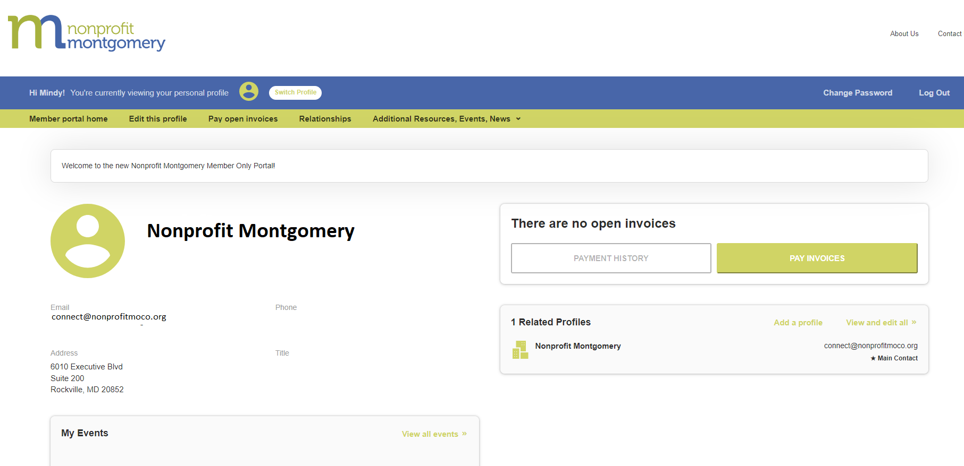
A Member’s Guide to the
Members-Only Area
An illustrated guide to getting the most out of our interactive self-service website
Brought to you by
Members Only home screen

Slide 2
Membership has its privileges
Our website is powered by MemberClicks by Personify, the association industry’s most powerful Association Management Software system.
Our website offers many self-service and exclusive benefits that only members and/or their employees can take advantage of.
To ensure only members receive these benefits, these areas of our site require a valid log in.
The pages in this guide will teach you how to log in and update your information, as well as take advantage of as many benefits as possible.
The more you update and personalize your membership, the more value you will receive from us!

Slide 3
What can I do here?
Update your contact information (plus organization information if you’re the main contact or an editor)
Pay invoices for any related profiles (main contacts/editors) Access members only content
Upload media (company logo, staff pictures, directory photo gallery and video)
Register for events
Access members only content
Change your password

Slide 4
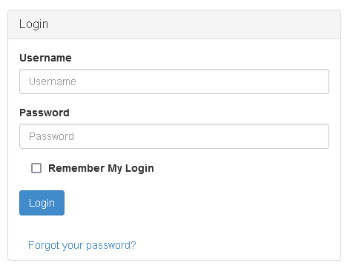
Log in to take control of your membership
You will need to use your username and password to gain access to our private Members Only Area.
If you ever forget your password, click the ‘Forgot your password?’ link to receive an email with a password reset link. Or email connect@nonprofitmoco.org.

Slide 5
Edit This Profile
This link will open a page that allows you to update much of the information on your profile. If you are an Editor for your related organization(s), you can click Switch Profile at any time to edit additional profiles. This helps us ensure we always have the latest information about you and your business.
You can edit the following information:
Name, address, and other basic contact information
Directory Listing category and descriptions
[Affiliation Codes or Custom Fields you have identified as visible to profiles]
Relationships you have to other profiles (including adding new profiles you are related to)
Social media accounts

Slide 6
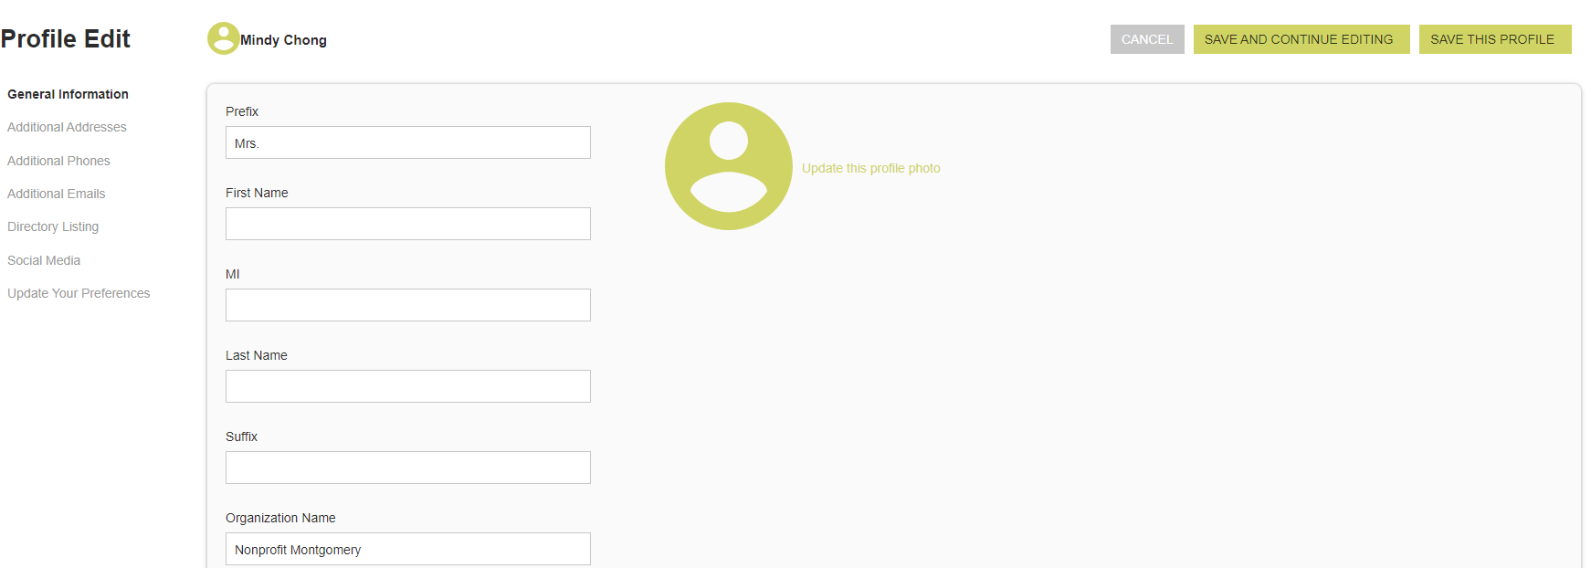
Edit This Profile
Edit My Profile screen
You have the ability to edit your profile. Staff marked as Main Contact or Editor are able to edit their related Organization(s) as well.
Once you make changes, they are submitted for approval by our association.
If you have the right permissions, you can also edit the profiles related to your organization.

Slide 7
View Invoices and Pay Membership Renewals
From the Members Only home page, Main Contacts and Editors can view all open invoices for their related profiles as well as renewal information
You can view Payment History and click to Pay Invoices.
Click Pay Open Invoices from top Navigation menu or the Pay Invoices button on the right side of the home page
Main Contacts and Editors will see company invoices, other staff will view only invoices connected to their individual profile
Select any invoices you would like to pay by checking the box in the first column
To print an invoice, click on the Invoice Number link.

Slide 8
Additional Resources – Members Only Content
You can access members only content and resources under the Additional Resources link in the top navigation menu

Slide 9
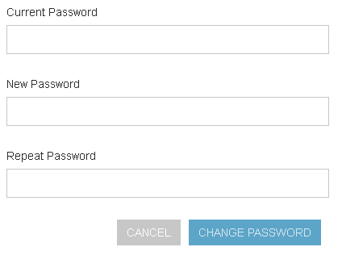
Change your password
The best parts of our website are restricted to only be used by members and their approved employees or related profiles. You can change your password at any time on the top right menu of the Members Only page.
Once you have a username and password, you can use it to access any members-only or restricted items, like event discounts and other self-service items we offer.

