Slide 1
Food Assistance Resources in Montgomery County
May 19th, 2021

Slide 2
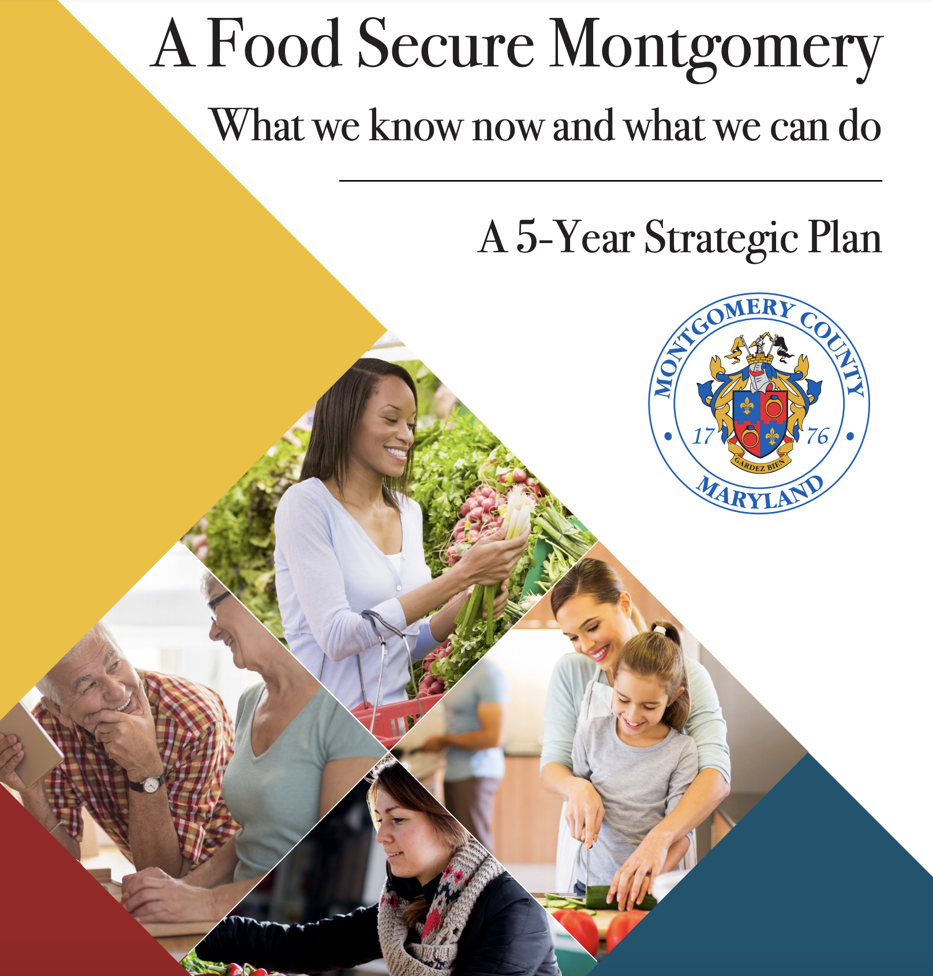
Food Security Plan
Bill 19-16 passed in July 2016 requiring delivery of Food Security Plan by December 2016
Plan development - Fall 2016
Food Security Plan released by the County Executive in January 2017
January 2017-Present: implementation and COVID-19 Response

Slide 3
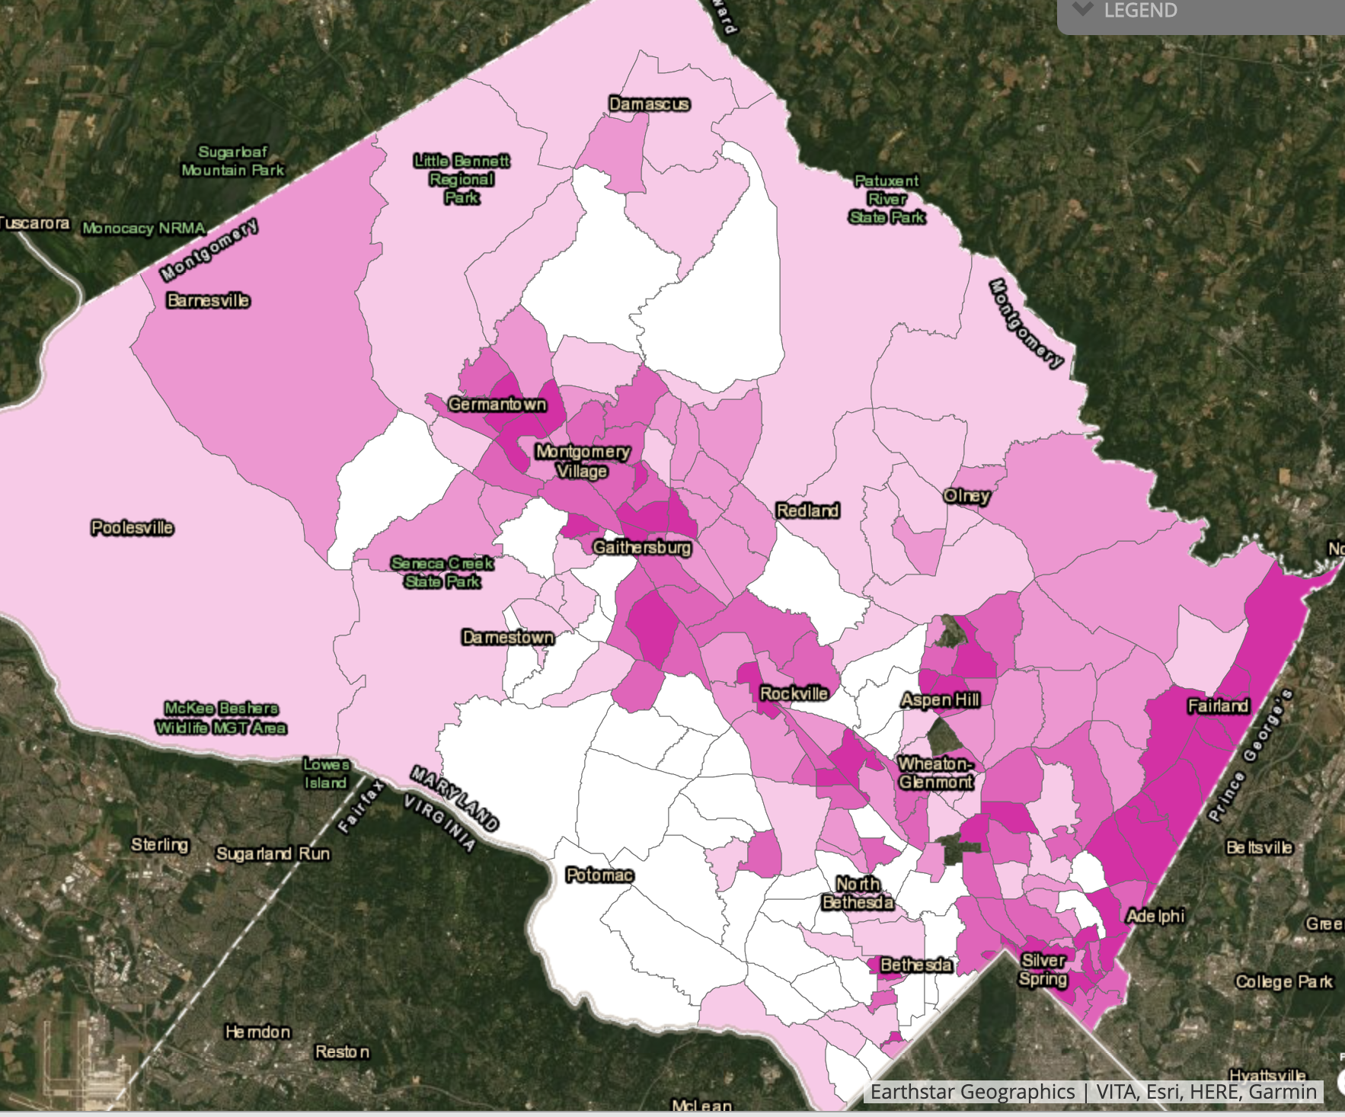

Slide 4
Montgomery County Food Security Plan Findings
Children
Children were found to have insufficient food during summer and on weekends, and had a higher food insecurity risk if they were living in single parent households and were children of color. Childhood food insecurity can, among other things, result in long-term poor health consequences, behavioral and social difficulties and poor school performance.
Seniors
6.6% seniors in Montgomery county are estimated to live below the poverty level, and around 20-30,000 live below the self sufficiency standard. Many are also aging in place and in isolation, with limited access to transportation and technology, limited English proficiency, physical and mental disabilities and medical dietary restrictions.
People with Disabilities
Families with a disabled member were estimated to be 2 to 3 times more likely to be food insecure. Working aged adults with disabilities are twice as likely to live below the poverty level as adults without disabilities. Barriers to food security include lack of case management, limited communication ability, restricted mobility, and access to transportation to purchase and/or prepare food.
Foreign Born
50-60,000 foreign born residents were living at or below 150% of the poverty level in 2016. Food insecurity in this population results from factors such as language and cultural barriers, a lack of culturally appropriate food, and fear of asking for help, especially in mixed documentation status families.
Other Risk Factors
living below the self-sufficiency standard
having limited access to transportation
being eligible but not enrolled in benefits
being homeless
having faith based dietary restrictions
working two or more jobs.

Slide 5
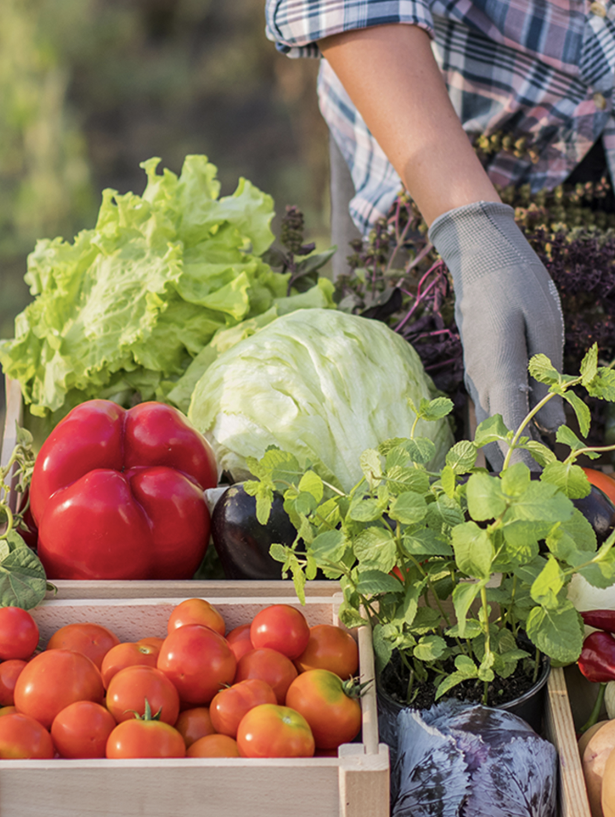
Food Resources: Government Programs
Supplemental Nutrition Assistance Program or “SNAP”
Provides nutrition benefits to supplement the food costs to individuals who may be food insecure. Apply online here.
Free and Reduced Price Meals or “FARMS”
Students may qualify depending on household size and income. Enrollment in Food Supplement Program (FSP) or Temporary Cash Assistance (TCA) benefits are also considered. Apply online here.
Pandemic Electronic Benefit Transfer or “P-EBT”
Designed to cover breakfast, lunch, and a snack for eligible children who would have received these meals at school in 2020-21 school year. Benefit is valued at $6.82 per day for a full virtual month of enrollment or hybrid enrollment month.
Maryland families receiving SNAP benefits, youth in foster care, and youth currently enrolled in FARMS. Latest on P-EBT: https://dhs.maryland.gov/p-ebt/ .
Women Infants and Children Program or “WIC”
Hold
School Meals
Hold
Meals for Seniors
Image source: https://www.myplate.gov/eat-healthy/vegetables

Slide 7
Food Resources: Government Programs
Special Supplemental Nutrition Program for Women, Infants, and Children or “WIC”
Available to women who are pregnant, postpartum (up to 6 months after the birth of of infant, or end of pregnancy), and breastfeeding; to infants (up to the infant's first birthday); and to children (up to 5th birthday). More info here.
Montgomery County Public School Meals Program
MCPS continues to provide free breakfast, lunch and dinner to all students in schools and at 24 designated food distribution sites. Meals are served Monday, Tuesday (double meal day), Thursday and Friday (triple meal day). No meal service on Wednesdays. Click here for sites and additional details.
Meals for Seniors
Montgomery County programs: senior congregate meal sites are currently closed. Frozen prepared meals and hot meals for participants continue to be delivered.
The State of Maryland is starting up the Senior Farmers Market Nutrition Program this year. Eligibility depends on age and income levels. Recipients will receive seven $5 coupons. Markets will be hosted at Senior Center and recreation sites. Registration will be managed through Montgomery County Recreation Department. More information about the State of Maryland program.

Slide 8
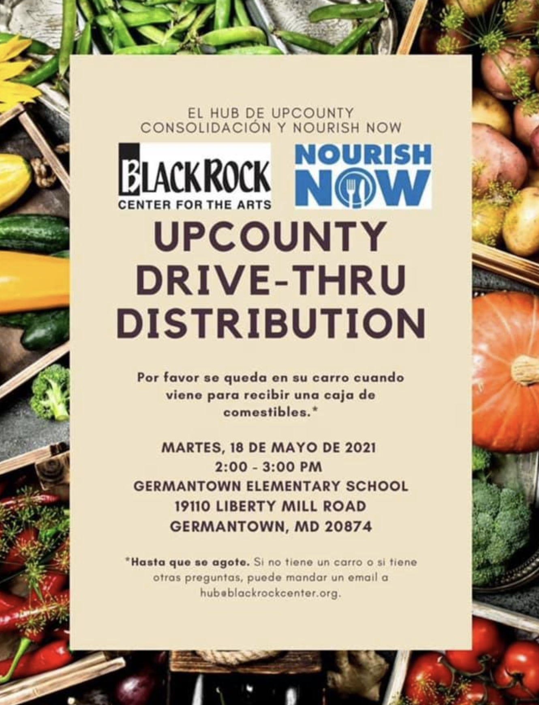
Food Resources: Nonprofit Sector
Shopping Assistance/Grocery Delivery Options
Farmer’s Markets
Food Pantries and other food assistance providers
Local events and other food assistance resources
Image source: UpCounty Consolidation Hub at BlackRock.

Slide 9
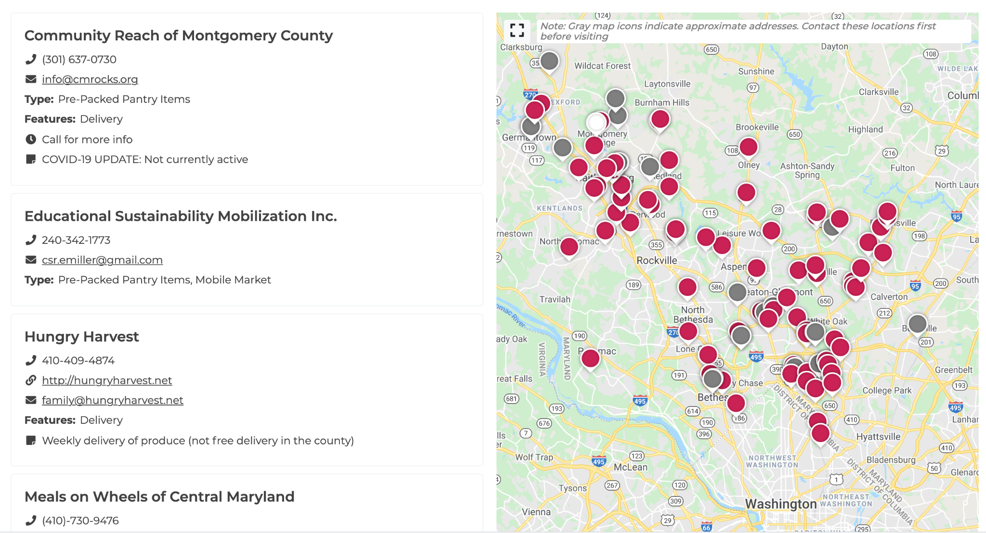
Interactive Food Assistance Resources Map
https://mocofoodcouncil.org/food-assistance-resource-map/

Slide 10
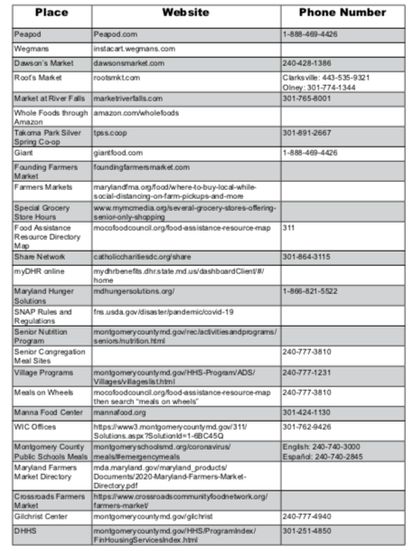
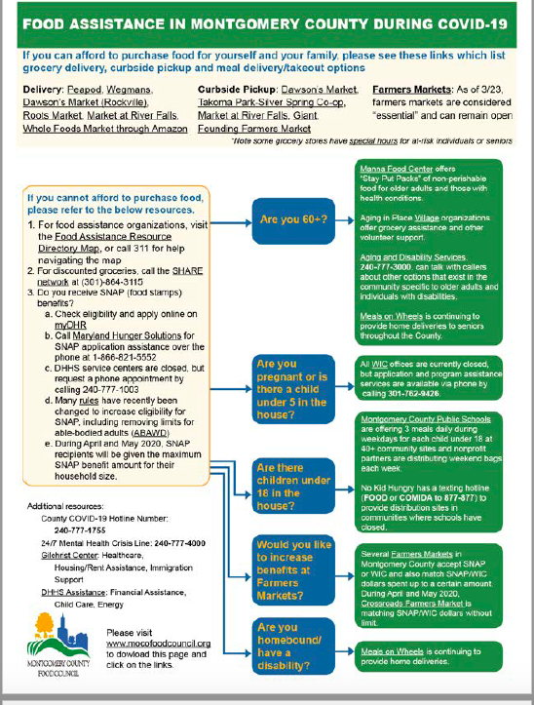
Food Assistance Referral Tool
https://mocofoodcouncil.org/wp-content/uploads/2020/05/Flow-chart-english.pdf

Slide 11
Other County Food Assistance Resources
311 Food Access Call Center
County Food Assistance Resources Page

Slide 12
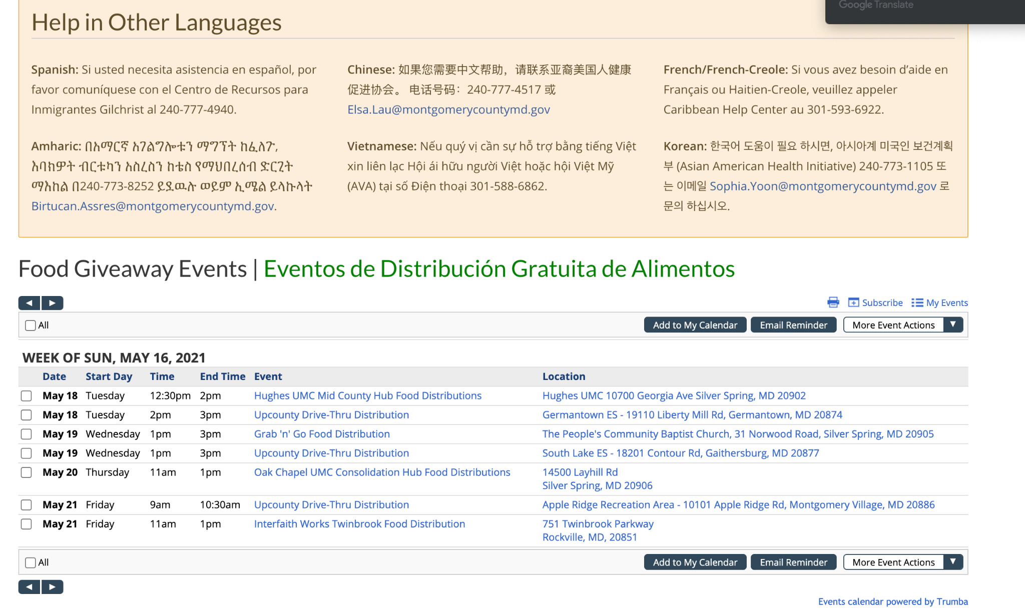
County Website: Resources in 6 Languages, Events
hold
hold - screenshot of county site

Slide 13
Summary of Resources:
Online Food Assistance Resource Directory
Food Assistance Referral Tool
County Food Assistance Resources Page, including calendar of food distribution events
Connect with the Food Council:
Join our Food Recovery and Access Working Group email listserv. Email susan@mocofoodcouncil.org to be added
Join our Bi-Weekly Community Call for the food assistance community and partners working on housing, energy assistance, mental health support systems, and more!
RSVP: mocofoodcouncil.org/events/communitycall
Visit our COVID-19 Response Resource Page for information for residents, community partners, food businesses and farms

Slide 14
Thank you!
Contact Information:
Susan Kornacki, Interim Food Security Programs Manager
susan@mocofoodcouncil.org
Heather Bruskin, Executive Director
hbruskin@mocofoodcouncil.org

