Slide 1
Customer Financial Assistance Programs
Kelly Caplan, Customer Engagement & Advocacy Division Manager, Kelly.Caplan@WSSCWater.com
April 7, 2021

Slide 2
Overview
Introduction
Current financial assistance resources
COVID-19 related actions
Q&A

Slide 3
US Water Alliance
All people need access to the basics – water, food, shelter… in order to participate fully in society. When these basic conditions are met, our communities and our economy thrive.

Slide 4
Here to Help
“COVID-19 has changed how much water our customers use on a daily basis and the added stress of a high bill can be difficult to manage. We know many customers will have questions about their bills, including those that receive estimated bills. We want our customers to know that we are here to help.”
Carla Reid, CEO and General Manager

Slide 5
Current WSSC Water Financial Assistance Programs Serving Pr. George’s & Montgomery County Customers
Customer Assistance Program (CAP)
Bay Restoration Fund (BRF) fee exemption
Water Fund
Flexible payment plans
Emergency Pipe Repair Loan Program/PipeER
Bill adjustment
Water conservation tips

Slide 6
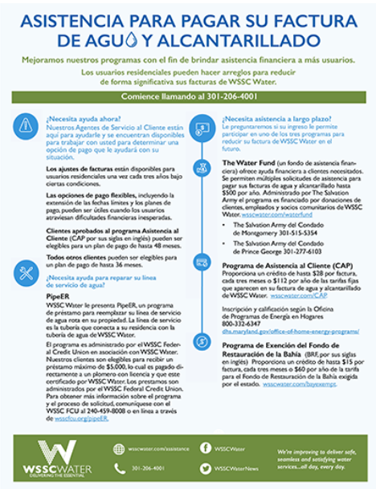
Financial Assistance Flyer wsscwater.com/assistance Spanish: wsscwater.com/asistencia

Slide 7
Flexible Payment Options
Extended due dates & pay plans to assist customers with unexpected financial hardship
Available for both residential & commercial accounts
CAP customers: up to 48-months
Non-CAP customers: up to 36-months
No minimum payment required for residential customers setting up pay plan

Slide 8
Customer Assistance Program (CAP)
Provides financial assistance to customers in need
Provides credit for fixed fees on water & sewer bills up to $28/quarter or $112/year
Customers are qualified & enrolled through county HHS or Social Services
Applicable to residential customers, including renters, when tenant pays bill
For more information: wsscwater.com/CAP
OHEP: 800-332-6347; dhs.maryland.gov/office-of-home-energy-programs/
Notes:
CAP-approved customers are automatically enrolled in the BRF Exemption Program.
Customers must re-enroll in CAP at the start of every fiscal year. Program year is from July 1 – June 30.

Slide 9
To Apply for CAP Program
Montgomery County
Health & Human Services
1301 Piccard Drive Rockville, MD 20850 (240) 777-4450 rapohep@montgomerycountymd.gov
Prince George’s County
Social Services
425 Brightseat Road Landover, Md. 20785 (301) 909-6300 pgcdss.energy@maryland.gov

Slide 10
OHEP Income Eligibility for CAP
2021 ELIGIBILTY GUIDELINES based on 175% of the federal poverty guidelines
Household Size | Household Annual Gross Income | Household Annual Gross Income
For families/households with more than 8 persons, add $7,840 for each additional person.
1 | $22,230
2 | $30,170
3 | $38,010
4 | $45,850
5 | $53,690
6 | $ 61,530
7 | $ 69,370
8 | $77,210

Slide 11
Total CAP Participants FY16 - FY21

Slide 12
Bay Restoration Fund (BRF) Exemption
Exemption program waiving state-mandated BRF fee (up to $15/quarter; $60/year) Customers certified for CAP automatically enrolled To enroll separately, customer must meet 2 of 4 criteria: Received assistance from WSSC Water Fund in past 12 months Recipient of food stamps or receive public assistance Recipient of Veteran’s Disability or Social Security Disability benefits Meet income requirements based on current tax return More information: wsscwater.com/bayexempt

Slide 13
The Water Fund
Flagship program offering direct financial assistance
Established in 1994 by WSSC Water employees
Funded by donations from WSSC Water customers, employees & community partners
Grassroots non-profit administered by The Salvation Army
WSSC Water pays all administrative costs
100% of donations go to water bill assistance

Slide 14
The Water Fund
Allows for multiple requests for emergency assistance with water/sewer bills, up to $500/year
Customers also can get assistance with food, clothing, energy bills & mortgage or rent
Eligibility is based on 200% of federal poverty guidelines
Application: salvationarmynca.org/gethelp

Slide 15
Water Fund – Income Eligibility
2021 Eligibility GUIDELINES BASED ON 200% OF FEDERAL POVERTY GUIDELINES
Persons in family/household | Annual Poverty guideline
For families/households with more than 8 persons, add $8,960 for each additional person.
1 | $25,520
2 | $34,480
3 | $43,440
4 | $52,400
5 | $61,360
6 | $70,320
7 | $79,280
8 | $88,240
Notes:
Federal Poverty Guidelines are updated every January

Slide 16
The Water Fund – Salvation Army
Montgomery County Prince George’s County
20021 Aircraft Drive 4825 Edmonston Road
Germantown, MD 20847 Hyattsville, MD 20781
Phone: (301) 515-5354 Phone: (301) 277-6103
Fax: (301) 515-7253 Fax: (301) 779-8020

Slide 17
How The Water Fund Helps
Since inception, nearly $1.6 million in assistance helping 17,344 customers
Since the pandemic began, the Water Fund has provided $386,000 assisting 2,929 people
Additional information about assistance: wsscwater.com/waterfund
Information about donating: wsscwater.com/donate

Slide 18
Emergency Pipe Repair Loan Program/PipeER
Loan program providing $100,000 annually to customers in need of emergency funds for service line replacement
Funds available on first-come, first-served basis until fund depleted
$5,000 maximum loan amount per customer
Program is administered by WSSC Federal Credit Union
Credit Union responsible for underwriting & administering loans
Any remaining dollars donated to Water Fund at fiscal year end
WSSC FCU: 240-459-8008; wsscfcu.org/piper
More information: wsscwater.com/pipeER

Slide 19
Bill Adjustment for CAP Customers
CAP-approved customers may be eligible to receive high bill adjustment removing 100% of excess water and sewer usage for one billing cycle in any three-year period.

Slide 20
Past Due Accounts/Amounts Top 10 Zip Codes – Montgomery County
Map shows percentage of past due accounts in all county zip codes.
Lightest shades reflect zip codes with lowest percentage & darkest shades show highest percentage of past due accounts.
10 zip codes had the highest rates of delinquency with between 16% and 24% of all accounts being past due.
20903, which includes the greater White Oak area & has 24% of past due accounts.

Slide 21
COVID-19 Related Actions
Compassionate Outreach
Letters/robocalls to set-up payment plans started in fall 2020; discuss other financial assistance programs
Moratorium on shutoffs
Recommendation by Attorney General to extend until January 31, 2021
WSSC Water continues to suspend disconnections
Suspension of late fees
Recommendation by Attorney General to extend until January 31, 2021
WSSC Water continues to waive late fees

Slide 22
Water Conservation Tips
When washing your hands, turn off the faucet while you scrub
Take shorter showers
Use the dishwasher instead of washing dishes by hand
Use your washing machine for full loads only
Install water-saving shower heads or flow restrictors
Find and repair any leaks
Toilet leaks are the most common cause of high water bills.
Water your lawn only when needed
Additional tips at wsscwater.com/conservation

Slide 23
Contact Information
WSSC Water Customer Service Center
Call Center Advisors: 301-206-4001
Available Monday – Friday, 7:30am to 7pm
Email: custserv@wsscwater.com

Slide 24
Questions?

